Slide 1
Reinforcement learning for Auto-Optimization of Accelerator Parameters
Presenter: Dennis Mintah Djan
Supervisor: Pham, Trong-Ton

Slide 2
Outline
Reinforcement Learning
Q-Learning:
Baseline Model
Dynamic Action Model(DAS)
Heuristic with Consecutive Updates (HCU)
Training Animations of Q-Learning
Results of Q-Learning
Deep Reinforcement Learning: Deep Q-Network(DQN), Double DQN, Dueling Network
- Results
- Next Steps

Slide 3
Reinforcement Learning

Slide 4
Machine Learning tasks
Reinforcement learning
Environment
State
+
reward
Action
Agent

Slide 5






Example of reinforcement learning
How to get to the other
side ?
inspired by: Matieu Pister

Slide 6
Q-Learning

Slide 7
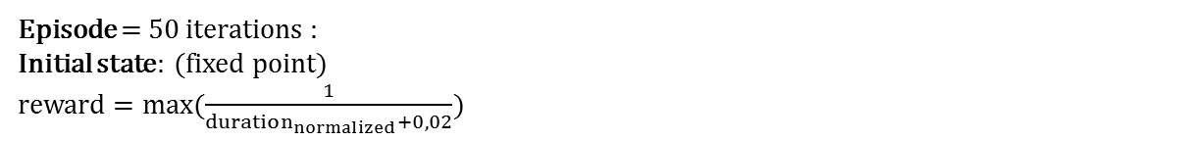
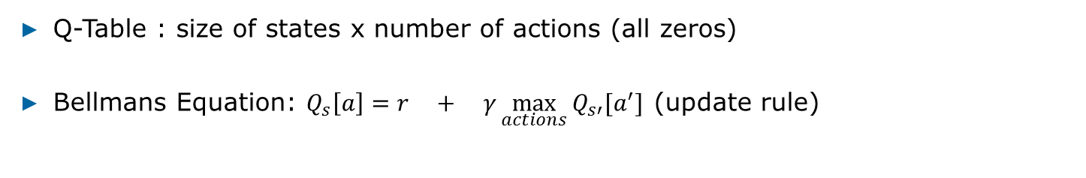
Q-learning : Training
Q-Table : size of states x number of actions (all zeros)
Bellmans Equation: $Q_{s}\left[a\right]=r + γ\max_{actions}{Q_{s′}[a^{′}]}$ (update rule)
Immediate
reward
Future
Reward
Episode = 50 iterations :
Initial state: (fixed point)
reward $=max(\frac{1}{duration_{normalized}+0,02})$

Slide 8
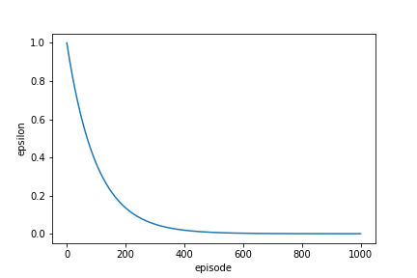
Exploitation vs Exploration
Exploitation: Make the best decision based on current information
Exploration: Gather more information
ε –greedy approach
- select random actions with probability ε
- exploit the Q-table with the probability 1- ε
- ε is set to 1 and annealed to 0 exponentially
per episode

Slide 9
Environment: Baseline Model
Action Space
Q-table
 | PS | CT | BS
1 | -STEP | 0 | 0
2 | +STEP | 0 | 0
3 | 0 | -STEP | 0
4 | 0 | +STEP | 0
5 | 0 | 0 | -STEP
6 | 0 | 0 | +STEP
7 | 0 | 0 | 0
State | Action1 | Action2 | Action3 | … | Action7
0 | 0 |  | 0 |  | 0
1 | 0 | 0 | 0 |  | 0
2 | 0 | 0 | 0 |  | 0
3 | 0 | 0 | 0 |  | 0
. . | . . | . . | . . |  | . .
n | 0 | 0 | 0 |  | 0
20
0
1 Action = 1 Update of one parameter
Agent: State 0
Action: 2

Slide 10
Pros and Cons
Pros
- Faster training time.
Cons
- Gets stuck in local optimum
-Slow exploration of the environment

Slide 11
Environment: Heuristic with Consecutive Updates (HCU)
Q-table
Action Space
State | Action1 | Action2 | Action3 | … | Action7
0 | 0 |  | 0 |  | 0
1 | 0 |  | 0 |  | 0
2 | 0 |  | 0 |  | 0
3 | 0 | 0 | 0 |  | 0
. . | . . | . . | . . |  | . .
n | 0 | 0 | 0 |  | 0
 | PS | CT | BS
1 | -STEP | 0 | 0
2 | +STEP | 0 | 0
3 | 0 | -STEP | 0
4 | 0 | +STEP | 0
5 | 0 | 0 | -STEP
6 | 0 | 0 | +STEP
7 | 0 | 0 | 0
0
20
0
40
0
60
1 Action = 1 Update of one parameter
Agent: State 0
Action: 2
action skip : 3
next state: state 3
$$action skip = round ((1 + delta)∗min_skip)$$

Slide 12
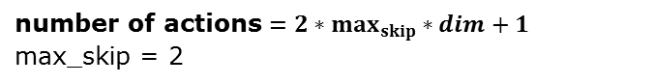
Environment: Dynamic Action Space Model
Action Space
 | PS | CT | BS
1 | -STEP | 0 | 0
2 | +STEP | 0 | 0
3 | -2*STEP | 0 | 0
4 | 2*STEP | 0 | 0
5 | 0 | -STEP | 0
6 | 0 | +STEP | 0
7 | 0 | -2*STEP | 0
8 | 0 | 2*STEP | 0
9 | 0 | 0 | -STEP
10 | 0 | 0 | +STEP
11 | 0 | 0 | -2*STEP
12 | 0 | 0 | 2*STEP
13 | 0 | 0 | 0
Q-table
State | Action1 | Action2 | Action3 | … | Action13
0 |  | 0 | 0 |  | 0
1 | 0 | 0 |  |  | 0
2 | 0 | 0 | 0 |  | 0
3 | 0 | 0 | 0 |  | 0
. . | . . | . . | . . |  | . .
n | 0 | 0 | 0 |  | 0
0
20
0
40
number of actions $=2∗max_{skip}∗dim+1$
max_skip = 2
Agent: State 0
Action: 1
State 1
Action 3

Slide 13
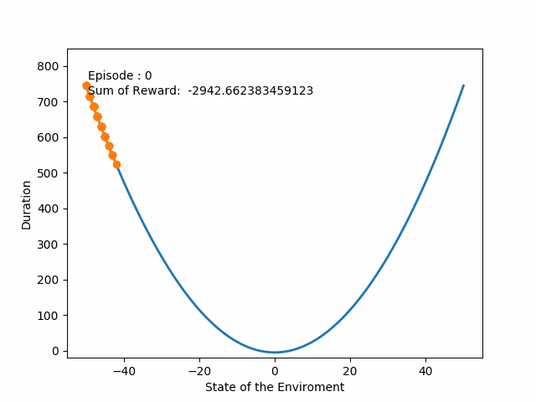
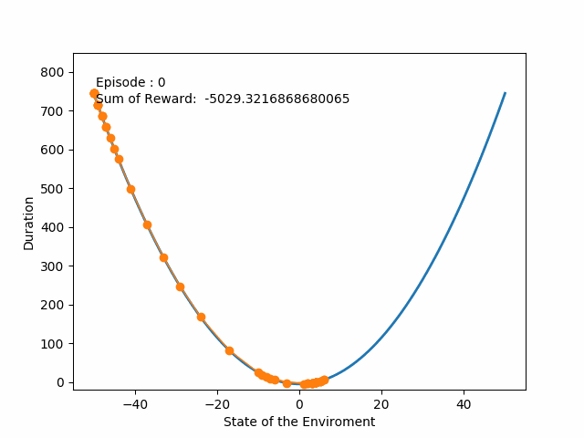
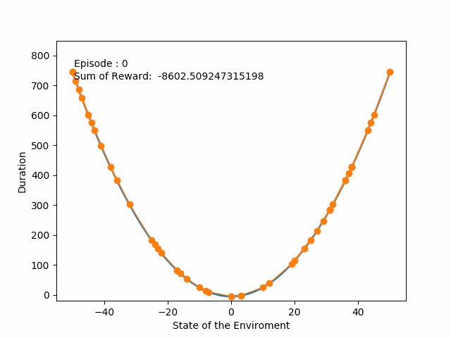
Training: Animation
Convex 1D
Baseline HCU DAS

Slide 14
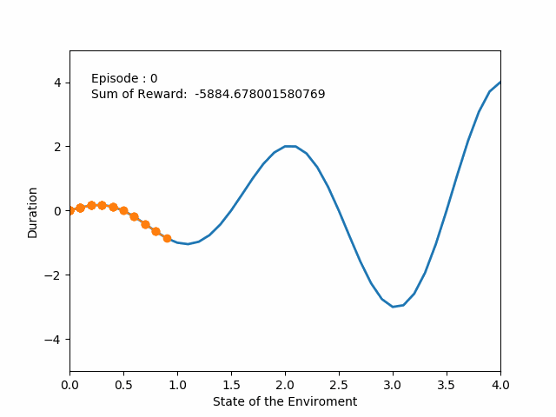
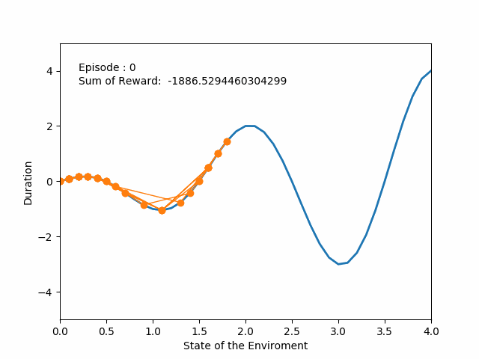
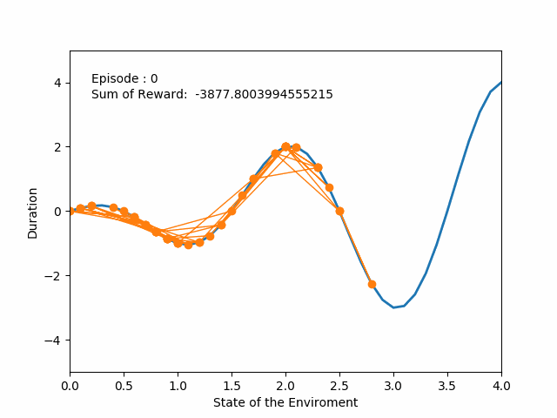
Training: Animation
Cosine 1D
Baseline HCU DAS

Slide 15
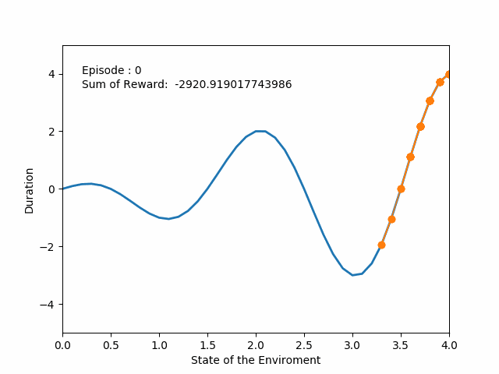
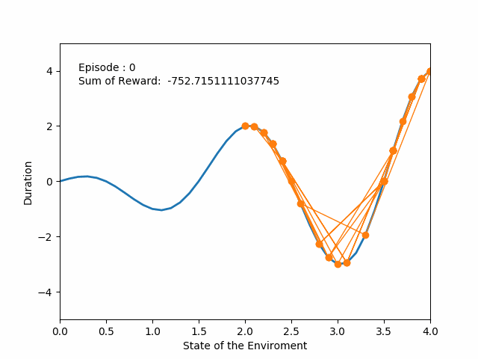
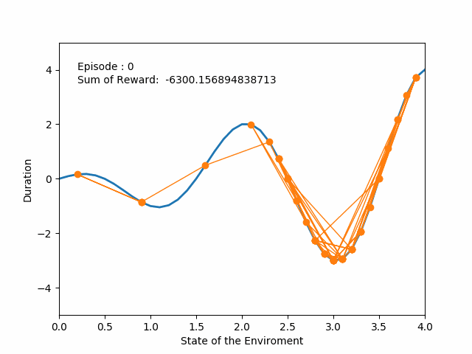
Training: Animation
Cosine 1D
Direction: Right
Baseline HCU DAS

Slide 16
Results

Slide 17
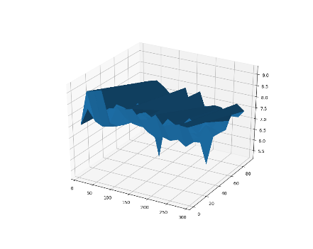
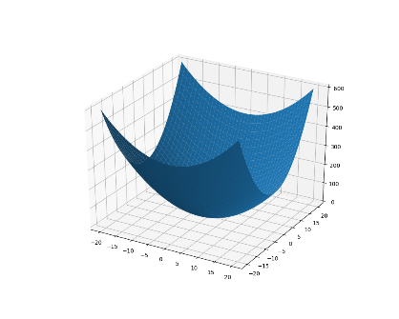
Dataset:
Theoretical Generated Datasets
LocalMinima2D
Convex 2D

Slide 18
Dataset: Summary
Name | Type | Size | Description
Convex 2D | Theoretical | 120 | Data generated using the function: f (x₁, x₂) = 0.5(x₁² + 2x₂² )
LocalMinima2D | Real | 150 | Name: fakeapp_stride_small_reads_small_lead The FIOL parameters were drawn according to a factorial design with the following values: SRO_SEQUENCE_LENGTH: min=10 max=300 step=20 SRO_CLUSTER_THRESHOLD: 7 SRO_DSC_BINSIZE: min=1048576 max=104857600 step=10485760
Dataset1 | Real | 168 | Name: fakeapp_stride_small_reads_big_lead The FIOL parameters were drawn according to a factorial design with the following values: SRO_CLUSTER_THRESHOLD: min=2 max=8 step=2 SRO_DSC_BINSIZE: min=1048576 max=11534336 step=2097152 SRO_PREFETCH_SIZE: min=1048576 max=32505856 step=5242880
Dataset2 | Real | 264 | Name: fakeapp_stride_big_reads The FIOL parameters were drawn according to a factorial design with the following values: SRO_CLUSTER_THRESHOLD: min=2 max=8 step=2 SRO_DSC_BINSIZE: min=1048576 max=11534336 step=2097152 SRO_PREFETCH_SIZE: min=1048576 max=32505856 step=3145728

Slide 19
Training: Metrics
Training Evaluation Metrics
Sum of reward
Number of steps to optimum
Number of steps agent stays in the optimum state

Slide 20
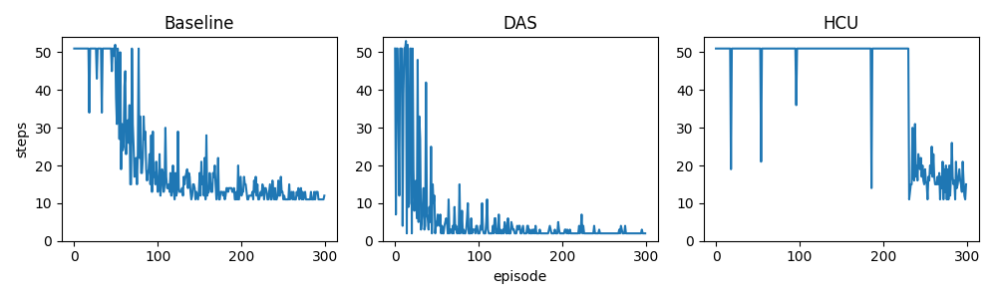
Results: Local Minima Direction: Left
Fig. 10 Variation of the steps the agent takes to get to the optimum state on Dataset1

Slide 21
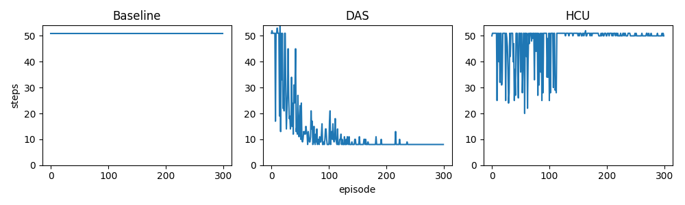
Results: LocalMinima Direction: Right
Fig. 10 Variation of the steps the agent takes to get to the optimum state on Dataset1

Slide 22
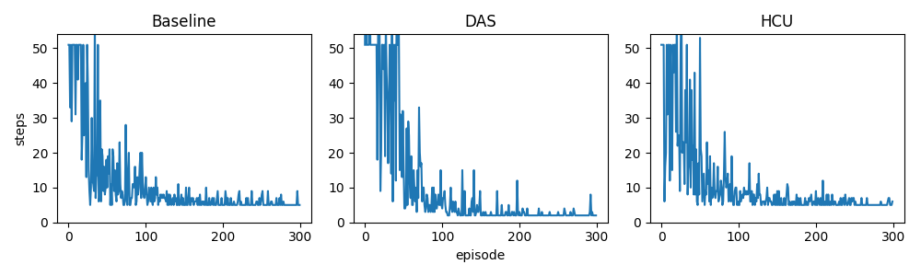
Results: Dataset1
Fig. 10 Variation of the steps the agent takes to get to the optimum state on Dataset1

Slide 23
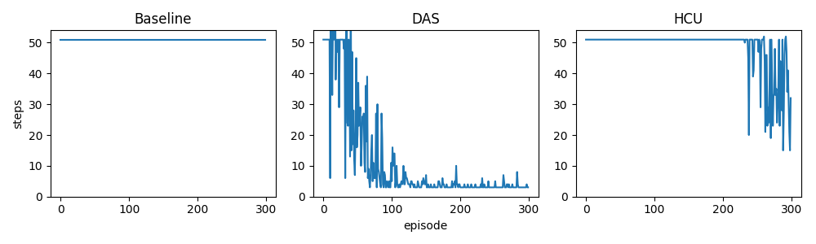
Results: Dataset2
Fig. 10 Variation of the steps the agent takes to get to the optimum state on Dataset2

Slide 24
Summary: Pros and Cons
Model | Pros | Cons
HCU | Action space remains unchanged | Increase in number of updates of the Q-table Takes fixed steps to the optimum
DAS | Learns skips inherently, hence shorter steps to the optimum | Action space increases by factor of max_skip

Slide 25
Deep Reinforcement Approach

Slide 26
Approaches:
Deep Q-Network (DQN)
Double Deep Q-Network(DDQN)
Dueling DDQN

Slide 27
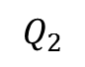
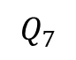
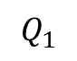
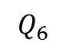
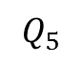
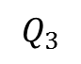
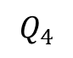
DQN and DDQN Architecture
hidden layer(s)
$$Q_{1}$$
$$Q_{2}$$
CT
$$Q_{3}$$
BS
$$Q_{4}$$
PS
$$Q_{5}$$
$$Q_{6}$$
$$Q_{7}$$

Slide 28
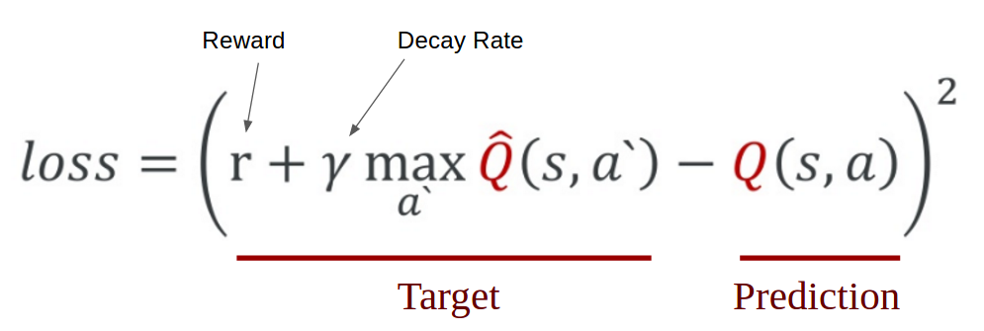
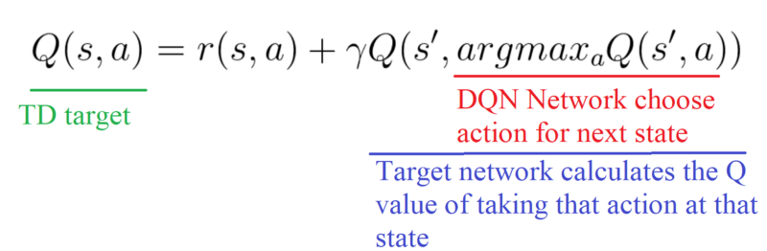
DQN and Double DQN
Shortcoming of DQN: Overestimation of target Values which
leads to slow convergence of the network.
DQN
LOSS
Double
DQN
LOSS

Slide 29
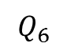
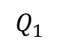
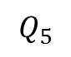
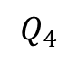
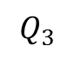
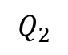
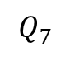
Dueling Architecture
$$Q_{1}$$
hidden layer(s)
V(s)
$$Q_{2}$$
CT
$$Q_{3}$$
BS
$$Q_{4}$$
PS
$$Q_{5}$$
A(s,a)
$$Q_{6}$$
V(s): the value of being at that state
$$Q_{7}$$
A(s,a): the advantage of taking that action at that state
Notes:
With DDQN, we want to separate the estimator of these two elements, using two new streams:
one that estimates the state value V(s)
one that estimates the advantage for each action A(s,a)
Wait? But why do we need to calculate these two elements separately if then we combine them?
By decoupling the estimation, intuitively our DDQN can learn which states are (or are not) valuable without having to learn the effect of each action at each state (since it’s also calculating V(s)).
With our normal DQN, we need to calculate the value of each action at that state. But what’s the point if the value of the state is bad?

Slide 30


Training and Results
Dataset | Model | DQN | DDQN | DUELING DDQN
2D QUADRATIC | BASELINE
 | DAS HEURISTIC
2D LOCALMINIMA | BASELINE
 | DAS HEURISTIC
DATASET1 | BASELINE
 | DAS HEURISTIC
DATASET2 | BASELINE
 | DAS HEURISTIC

Slide 31
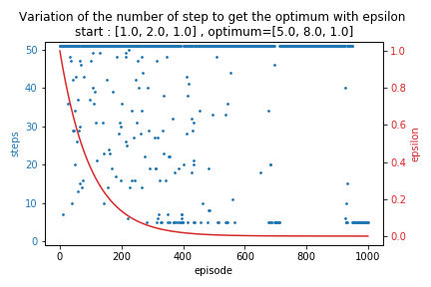
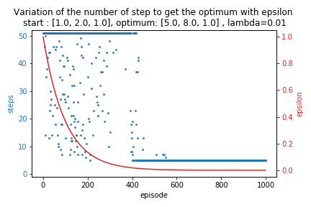
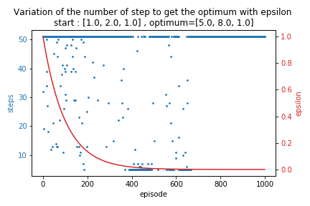
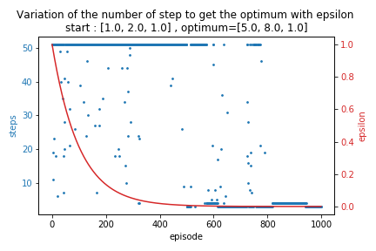
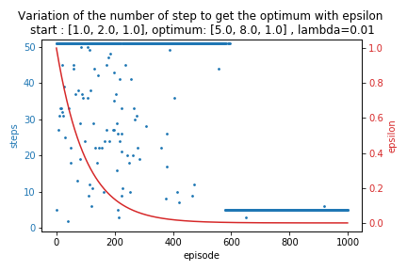
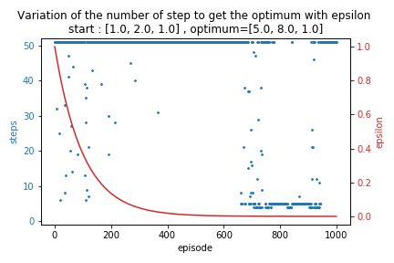
Results: Dataset1
DQN
DDQN
DUELING
Baseline
DAS

Slide 32
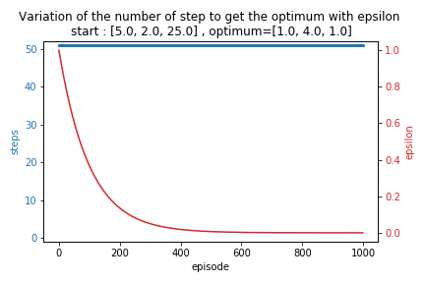
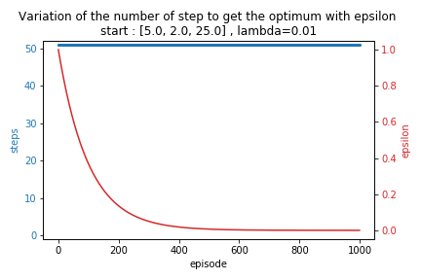
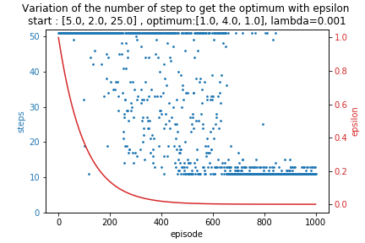
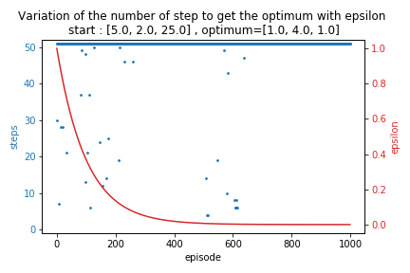
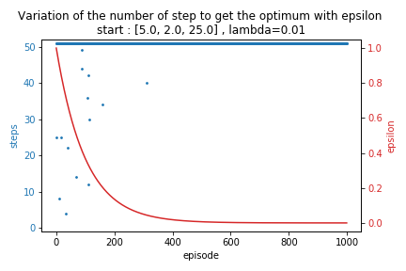
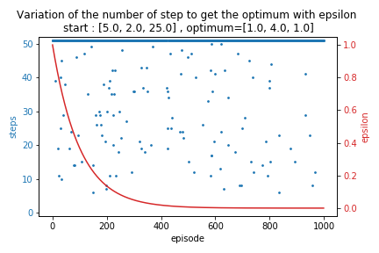
Results: Dataset2
DQN
DDQN
DUELING
Baseline
DAS

Slide 33
Next Steps
Tuning of hyperparameters with DAS model on Dueling Network
New Agents: Double DQN with Prioritized Experience Replay
Multi starts test for Dueling Network
Combination of classification model(RNN, LSTM) to complete Deep Reinforcement Learning Model.

Slide 34
Thanks For more information please contact: T+ 33 1 98765432 F+ 33 1 88888888 M+ 33 6 44445678 firstname.lastname@atos.net

